Slide 1
CARE-O-BOT
Objective: Demonstrate the behavior of a selected robot in a defined scenario.
Scenario:
Elder person’s home.
Robot programmed to take care of the elder person.
Milestone Requirements:
Present a home environment with:
A fixed robot.
A mobile robot.
Mobile robot's capability to move within the environment.
Final Demonstration Requirements:
Mobile robot must:
Move from one room to the elder person.
Perform a selected task (transport a glass to the elder’s bed and assist in drinking).

Slide 2
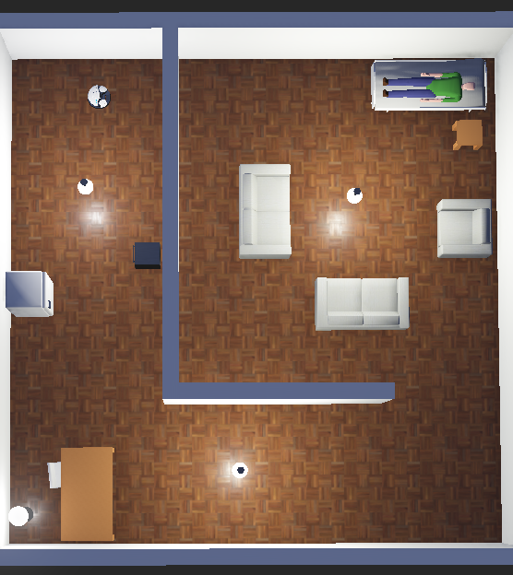
Webots Environment Creation
Webots is a 3D simulation software for robotics modeling and testing.
Includes a home environment setup for elderly care.
Simulated household objects: Fridge, oven, furniture, and hospital bed.
Two robots: Fixed robotic arm (NED 6DOF) and mobile robot (Robotino).

Slide 3
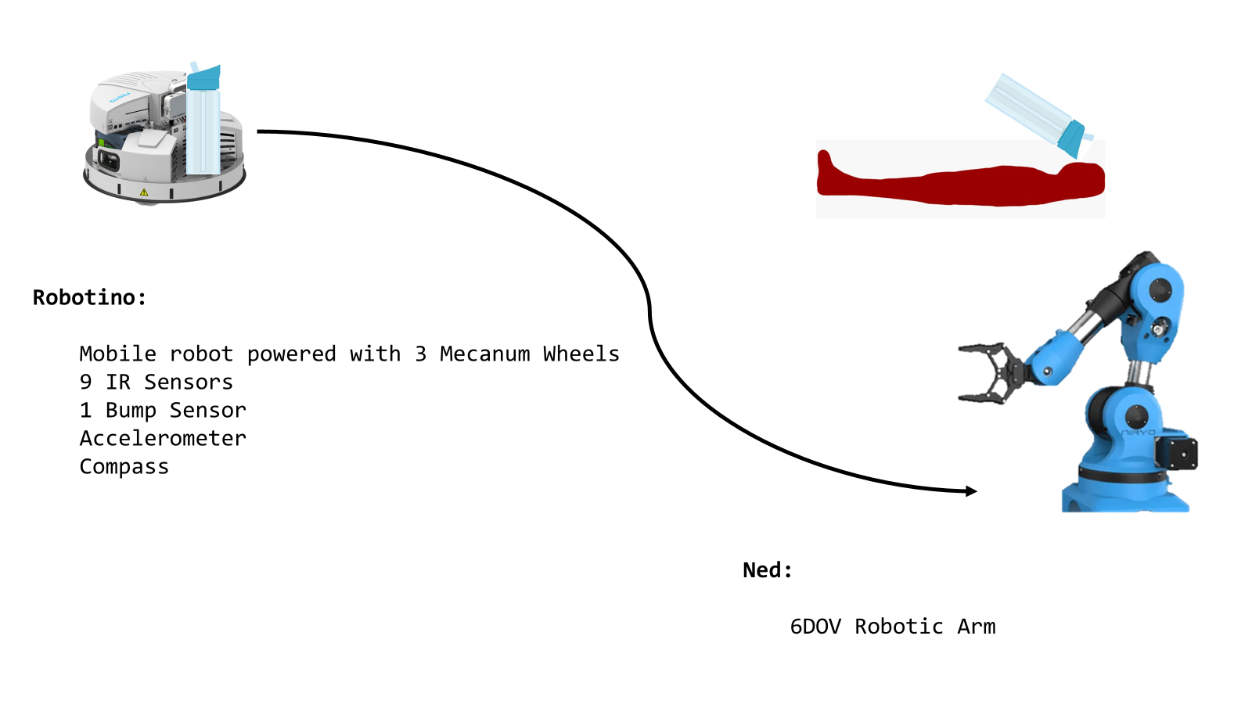
Robot Description

Slide 4
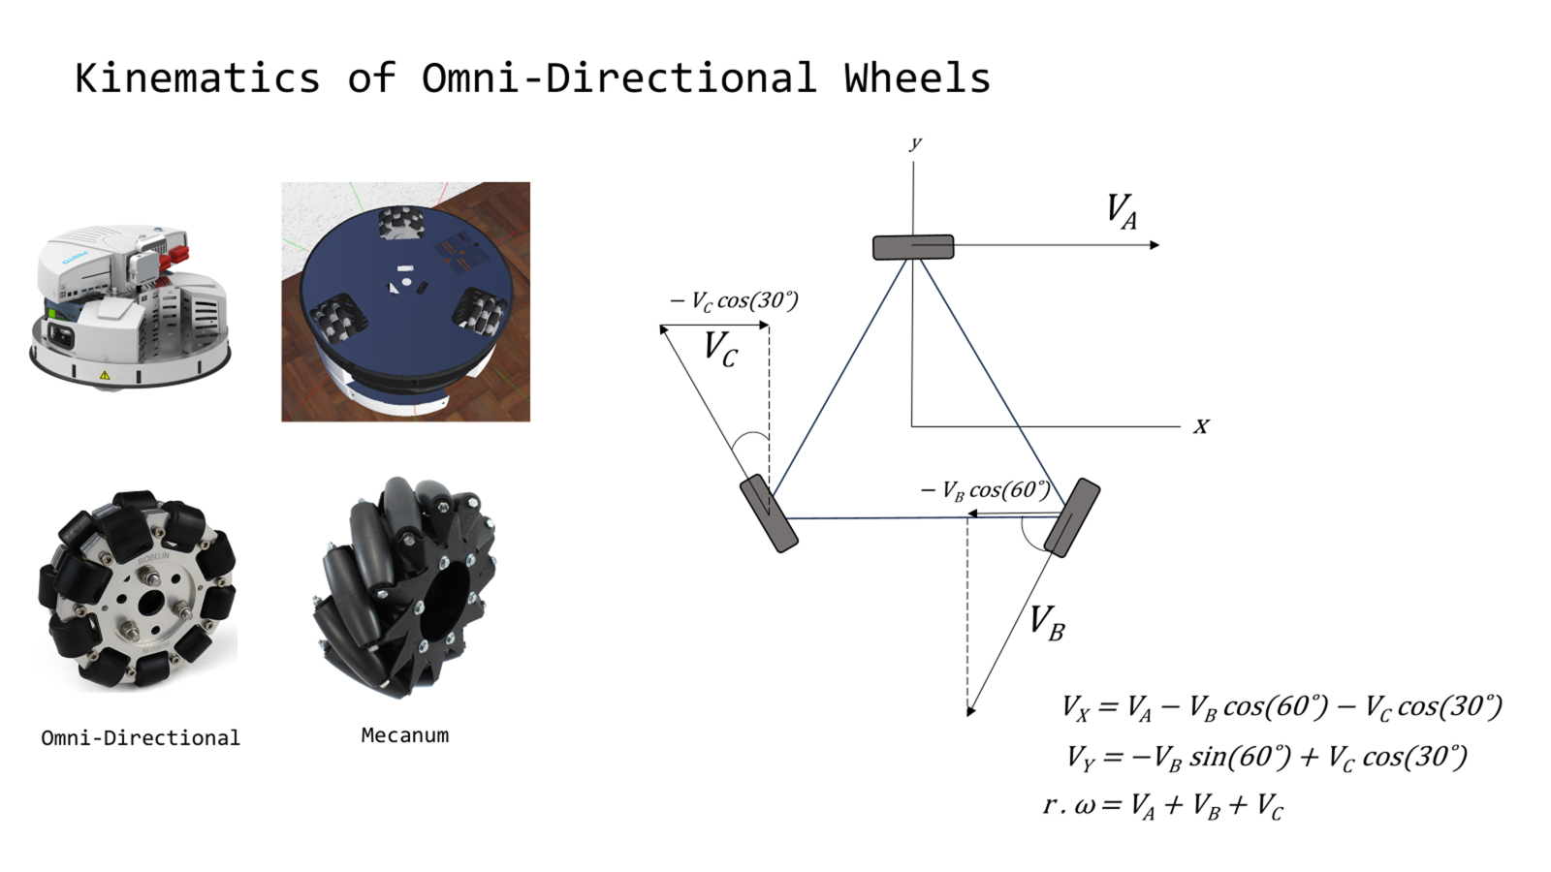

Slide 5
A * Algorithm
Utilizes heuristic-based cost calculation for optimal pathfinding
Supports dynamic updates for real-time navigation adjustments
Developed in Python for seamless integration with Webots
Converts the grid into a suitable format and identifies start & end nodes
Considers diagonal movements for improved efficiency
Returns the computed path as a list of coordinates

Slide 6
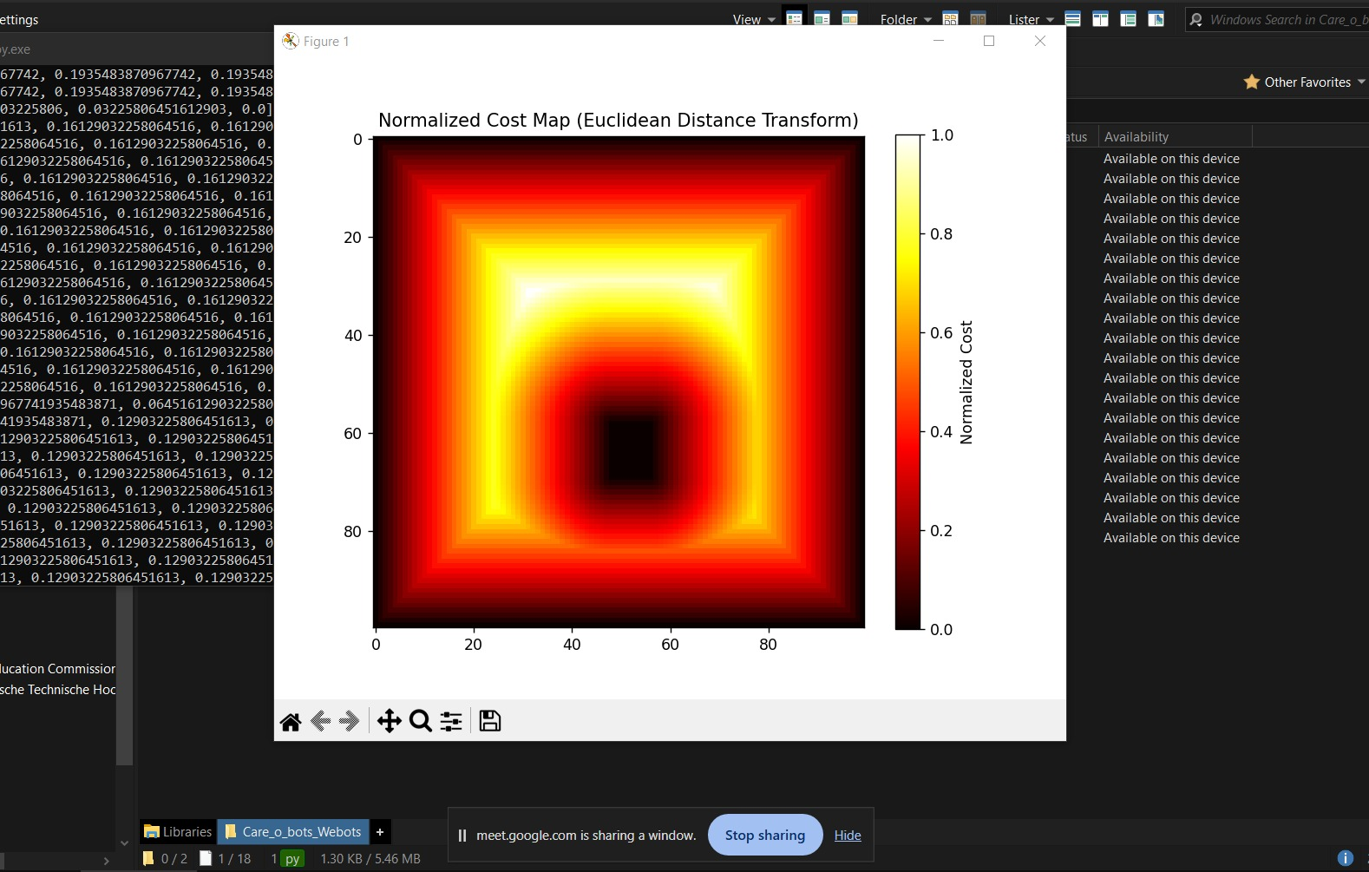
Costmap
Essential for representing obstacles and identifying safe zones
Provides a detailed layout of static and dynamic obstacles
Enables informed navigation decisions by integrating with the A* algorithm
Utilizes Webots and specialized costmap generation libraries
Temporary boundary walls define navigation constraints

Slide 7
Centroid-Based Obstacle Avoidance Polygon
IR values covered to reference world coordinates.
Treating IR values as a polygon.
Finding the centroid of this polygon.
Creates a polygon using IR sensor data
Computes the centroid to determine the best path.
The centroid calculation adjusts the robot’s path dynamically
The goal is to keep the obstacles out of the circle
c

Slide 8

Pure Pursuit Path Planning
The robot follows a target point along a predefined path.
It looks ahead to anticipate turns and avoid sharp movements.
Uses a look-ahead distance to find the next waypoint.
Adjusts speed and direction dynamically.

Slide 9
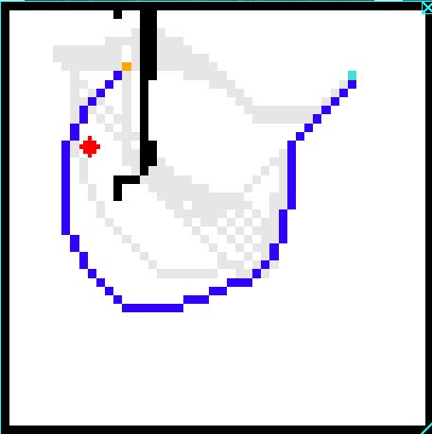
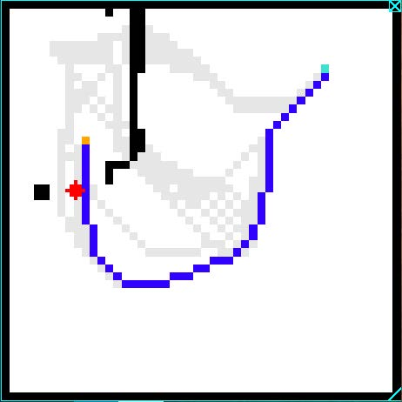
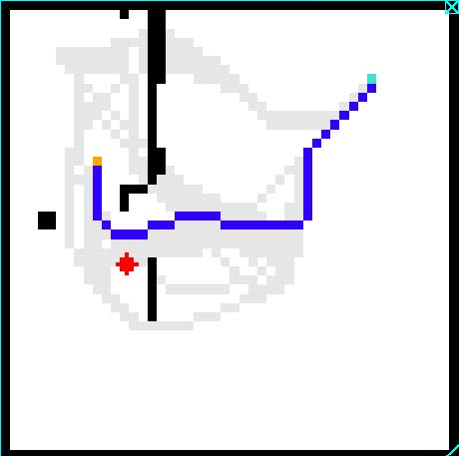
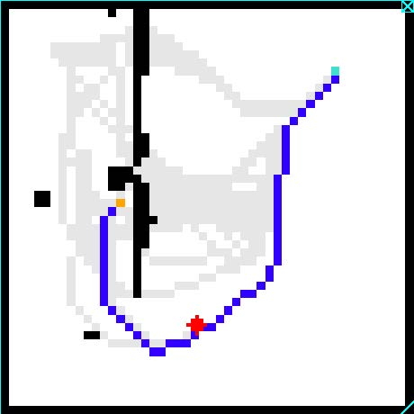
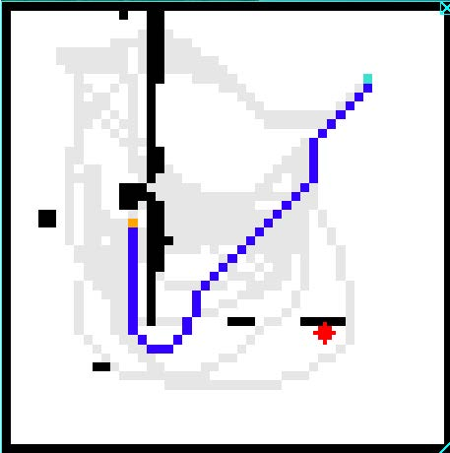
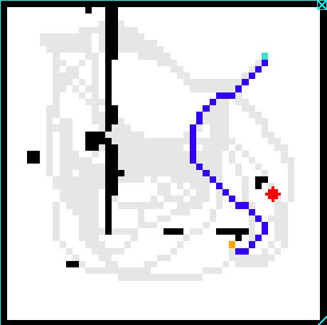
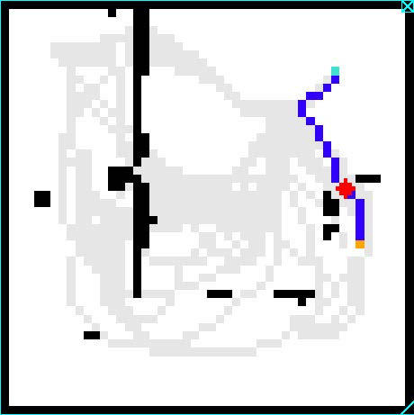
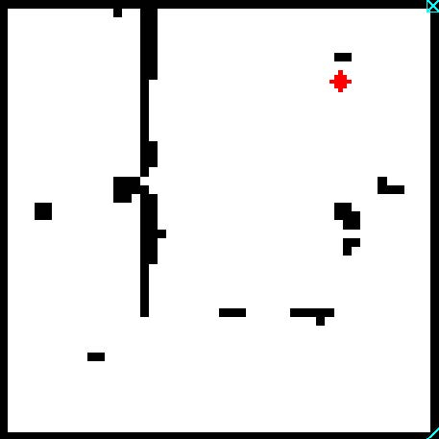
Grid Drawing for Navigation
Each cell represents a navigable area or obstacle.
The robot maps surroundings in real time.
Uses a grid-based model for optimized pathfinding.
The environment is divided into grid cells.
1
2
3
4
5
6
7
8

Slide 10
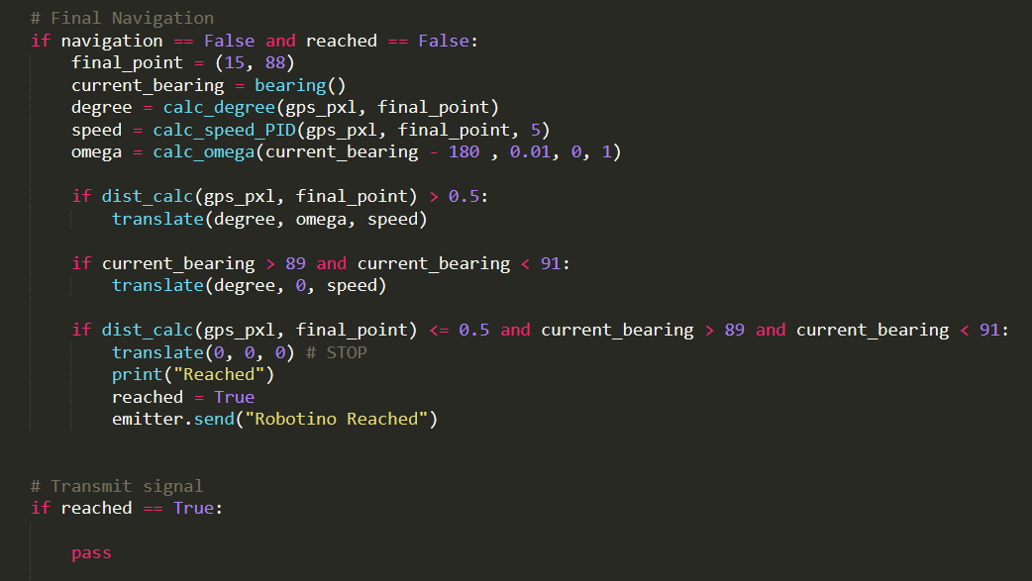
Final Nav and Comms

Slide 11
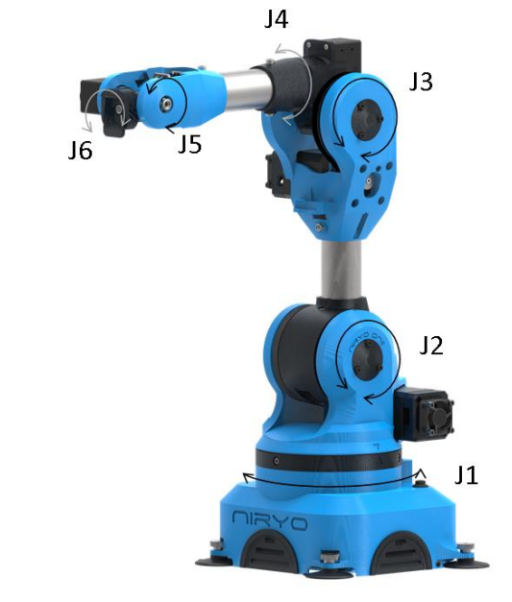
Ned Robotic Arm Control
range_dict = { "m1": ( 0.8, -0.8, 45, 135 ), # "joint_name": (limit_1, limit_2, angle_1, angle_2)
"m2": ( 1.3, -1.5, 15, 176.57 ),
"m3": ( 1.5, -1.5, 3.43, 176.57 ),
"base": ( 2.8, -2.8, 175, -175),
"twist1": ( 2, -2, -15, 195),
"twist2": ( 2.5, -2.5, -142, 322),
"gripper": ( 0.01 , -0.01 , 0, 1)}

Slide 12
Ned Robotic Arm Control : Outlook
Inverse Kinematics Approaches:
Generalized Solution for 6DOF Arms
Gradient Descent Optimization
Denavit–Hartenberg parameters
Neural Network-Based Control

Slide 13
Care - o - Bots
Project_Goal:
Two robots to be programmed to take care of a person on a bed by assisting them to drink water.
Project_Milestone:
A home environment with a fixed and a mobile robot in it. The mobile robot must be able to move within this environment.
Final_Demonstration:
The robot must be able to move from one room to the elder person, perform a selected task and roll back. The task here is to transport a glass to the elder’s bed and hold them the drink while drinking.

Slide 14
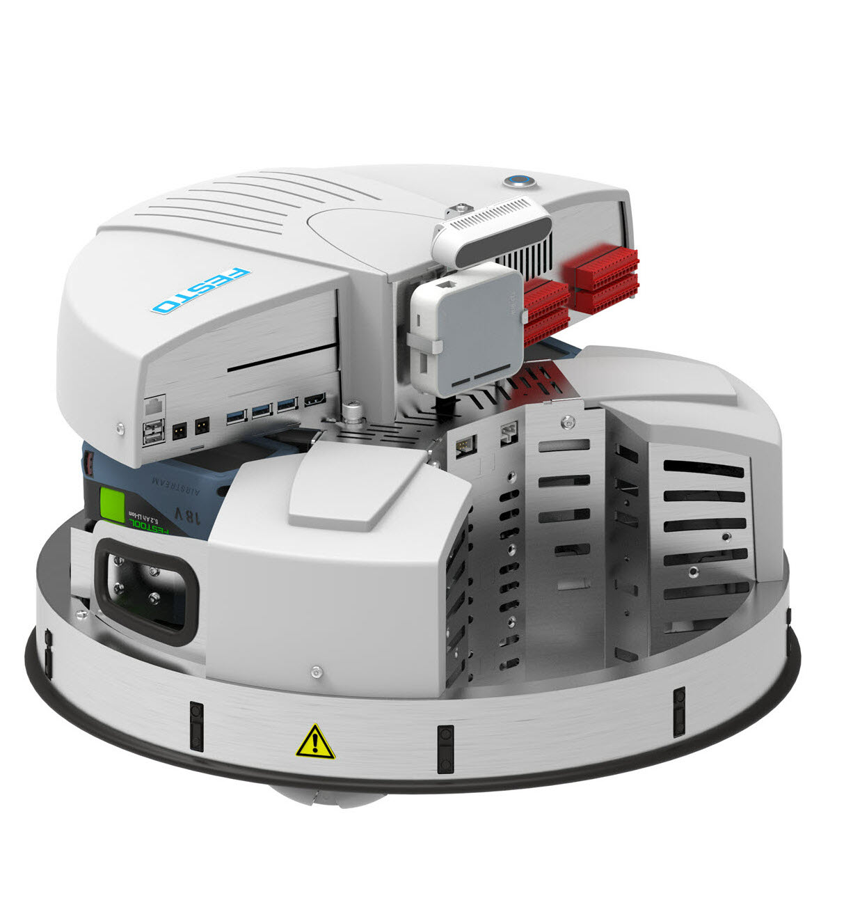
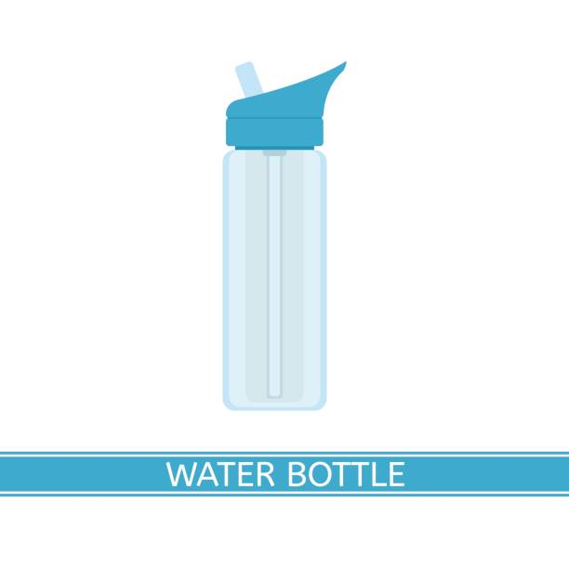

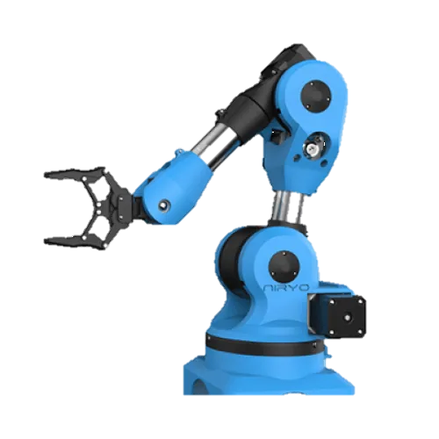
Robotino:
Mobile robot powered with 3 Mecanum Wheels
9 IR Sensors
1 Bump Sensor
Accelerometer
Compass
Ned:
6DOV Robotic Arm

Slide 15
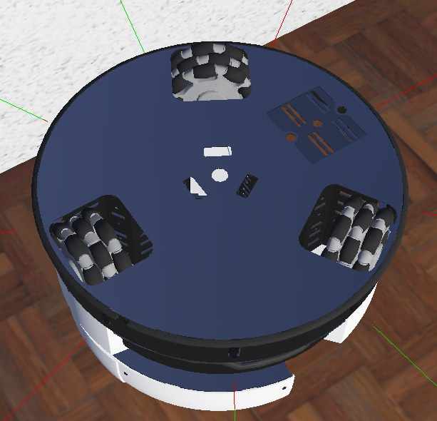
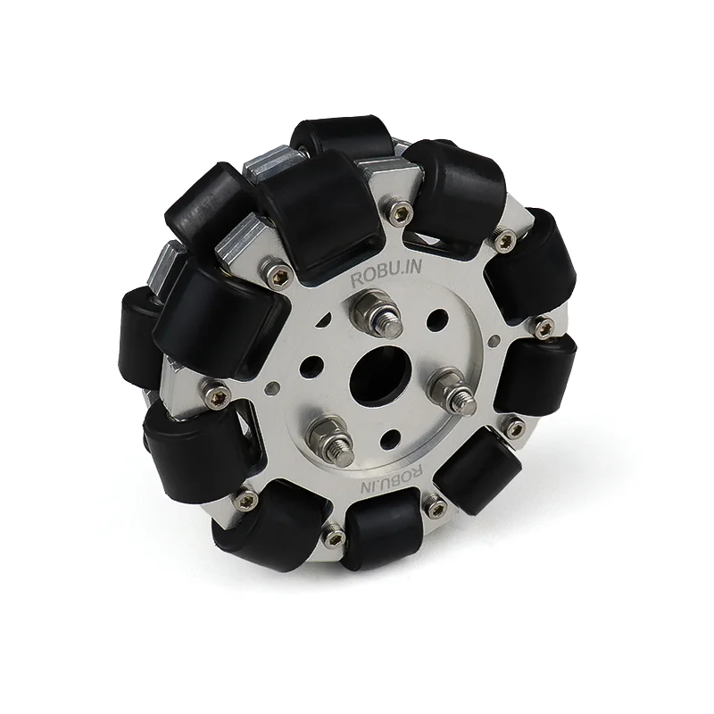
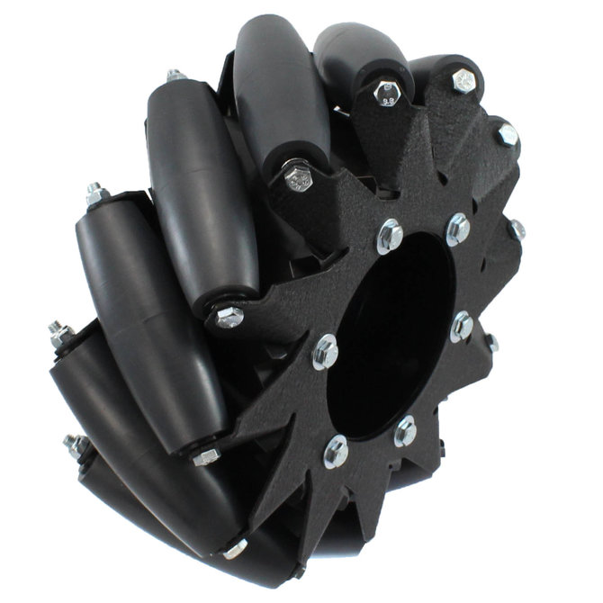
Kinematics of Omni-Directional Wheels
_{y}
V_{A}
+ V_{C} cos(30˚)
V_{C}
x
− V_{B} cos(60˚)
V_{B}
V_{X} = V_{A} − V_{B} cos(60˚) + V_{C} cos(30˚)
Omni-Directional
Mecanum
V_{Y} = −V_{B} sin(60˚) + V_{C} cos(30˚)
r . ω = V_{A} + V_{B} + V_{C}

Slide 16
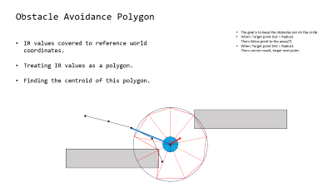
Obstacle Avoidance Polygon
The goal is to keep the obstacles out oV the circle
When: Target point Dist < Radius1 Then: Move point to the away(?)
When: Target point Dist < Radius1 Then: cannot reach, target next point.
IR values covered to reference world coordinates.
Treating IR values as a polygon.
Finding the centroid of this polygon.
c

Slide 17
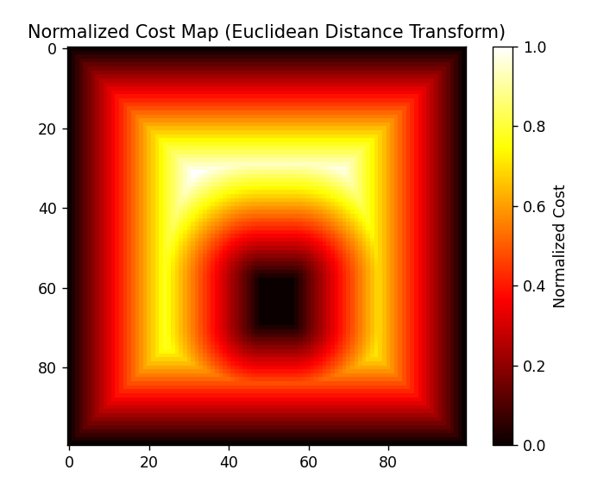
Grid Cost Mapping
Lower costs further away from the walls
The path algorithm will prefer the lower costs.
Normalizes at the end.
Euclidean Distance Transform

Slide 18
Path Finding
A* Search Algorithm
Uses the cost map generated by edt.
Diagonal Search enabled
Pure Pursuit
Look Ahead at bit
Start from the nearest path point

Slide 19
The goal is to keep the obstacles out oV the circle
When: Target point Dist < Radius1 Then: Move point to the away(?)
When: Target point Dist < Radius1 Then: cannot reach, target next point.
c
c

Slide 21
1m = 0.90436 gps
1m = (600/10) pxl

